Slide 1
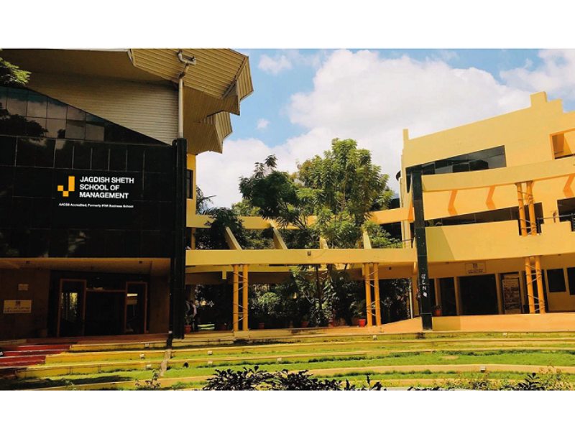


Design Thinking
Jagdish Sheth School of Management

Slide 2
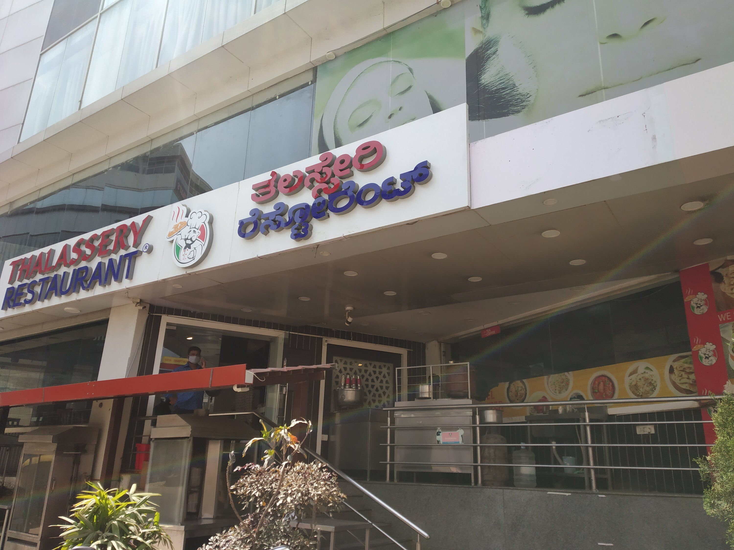
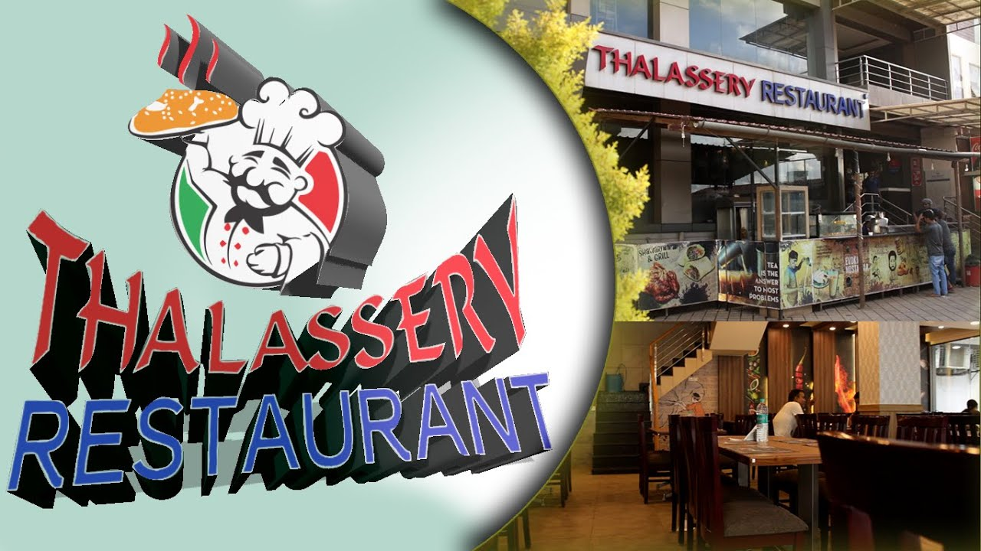

Slide 3


Slide 4

QR CODE menu with payment integration and Restaurant Service Training Module This solution will solve problems of all regional restaurants in India who face linguistic barrier between customer and serving staff, and A zero cost training module to increase overall customer experience.

Slide 5
How I found the Problem /Possibility
The problems were found from social media, google review.
We visited the restaurant, and saw one customer was having difficulty with menu selection, ordering confusion was there.
Lack of employee training was visible when restaurant had mass booking/ full capacity.

Slide 6

Problem Statement 1
How might we help Thalassery restaurant improve customer satisfaction review from 3.4 to 4.5 in 2 month because of insights like-
Service staff recruited from north and north east are unaware of South Indian dish names
Clash among the service staff (old staff and new recruits) on who will serve the customer first
Even after we train service staff customer reviews on service staff are still bad
Staircase to restaurant entrance was difficult to traverse for handicapped persons and pregnant women

Slide 7
Problem Statement 2
What might we do for Thalassery decrease the ordering and final food delivery delay from average 8.2 min to 5 min in 2 months?
1
Because of insights like- long waiting time
2
long queuing time
3
customer gets anxious as no update about food preparation is given
4

Slide 8

Solution
Solution 1- A QR code backed with a full-fledged website behind that will takes care of selecting menu, which food article is available, how long the cooking time will be, is your dish prepared or not, quick QR code payment solutions, feedback within that interface.
All of this will be finally integrated with company’s software and done predictive analytics to know which food has most demand, what safety stock can be maintained, seasonality of demand, bulk order fulfillment, and customization of service as per customer satisfaction rating and reviews.
Solution 2- (Improving service quality)- Restaurant serving employees training module has been developed as per the establishment’s demand. This module is cost effective. This can be put in learning portal of company’s website only for employees. Examples- silver service (mixed) technique, how to greet customers.
Solution 3: sloping ramp or a platform lift for elderly, disabled, and pregnant women. This solution requires money to build the ramp or lift, but will eventually increase customer experience and positive word of mouth

Slide 9
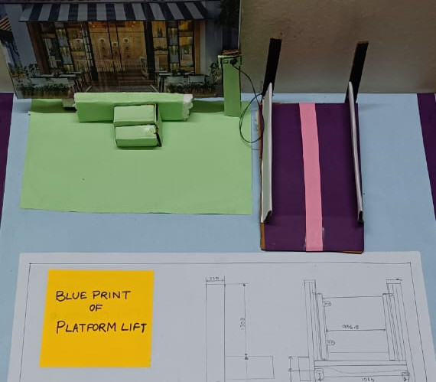
Prototype 1
Platform lift for elderly, disabled persons, pregnant women

Slide 10
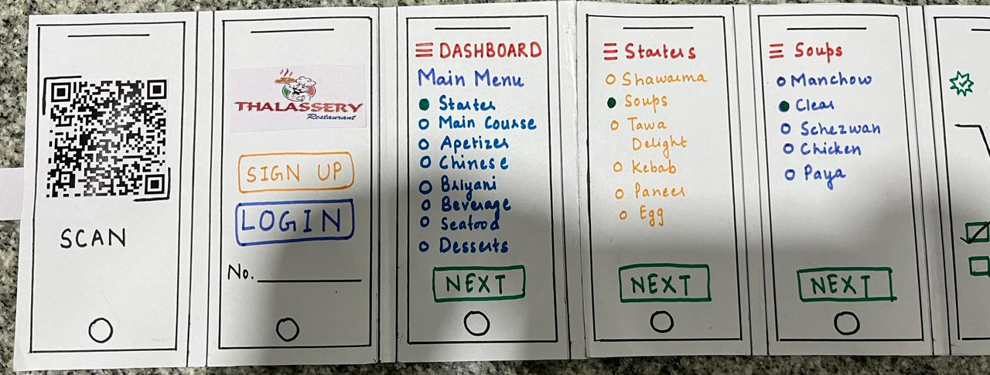
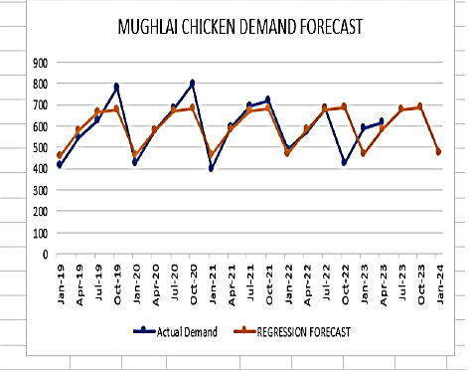
Prototype 2
Using QR code for seamless menu selection, payment integration, and feedback followed by predictive analytics

Slide 11
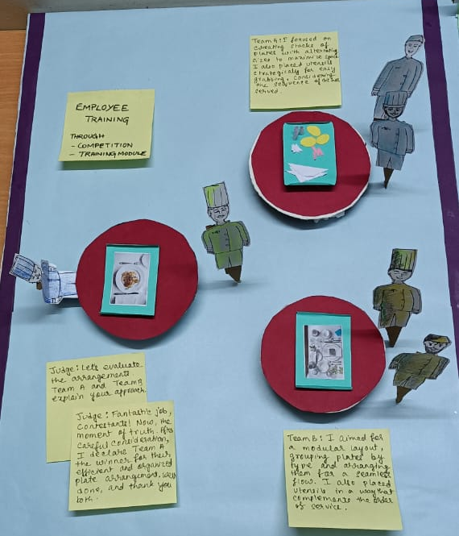
Prototype 3
Restaurant serving staff training module, Demonstrations, competitions, team building games will help to handle difficult customers , peak time, best learning guide for entry employees

Slide 12
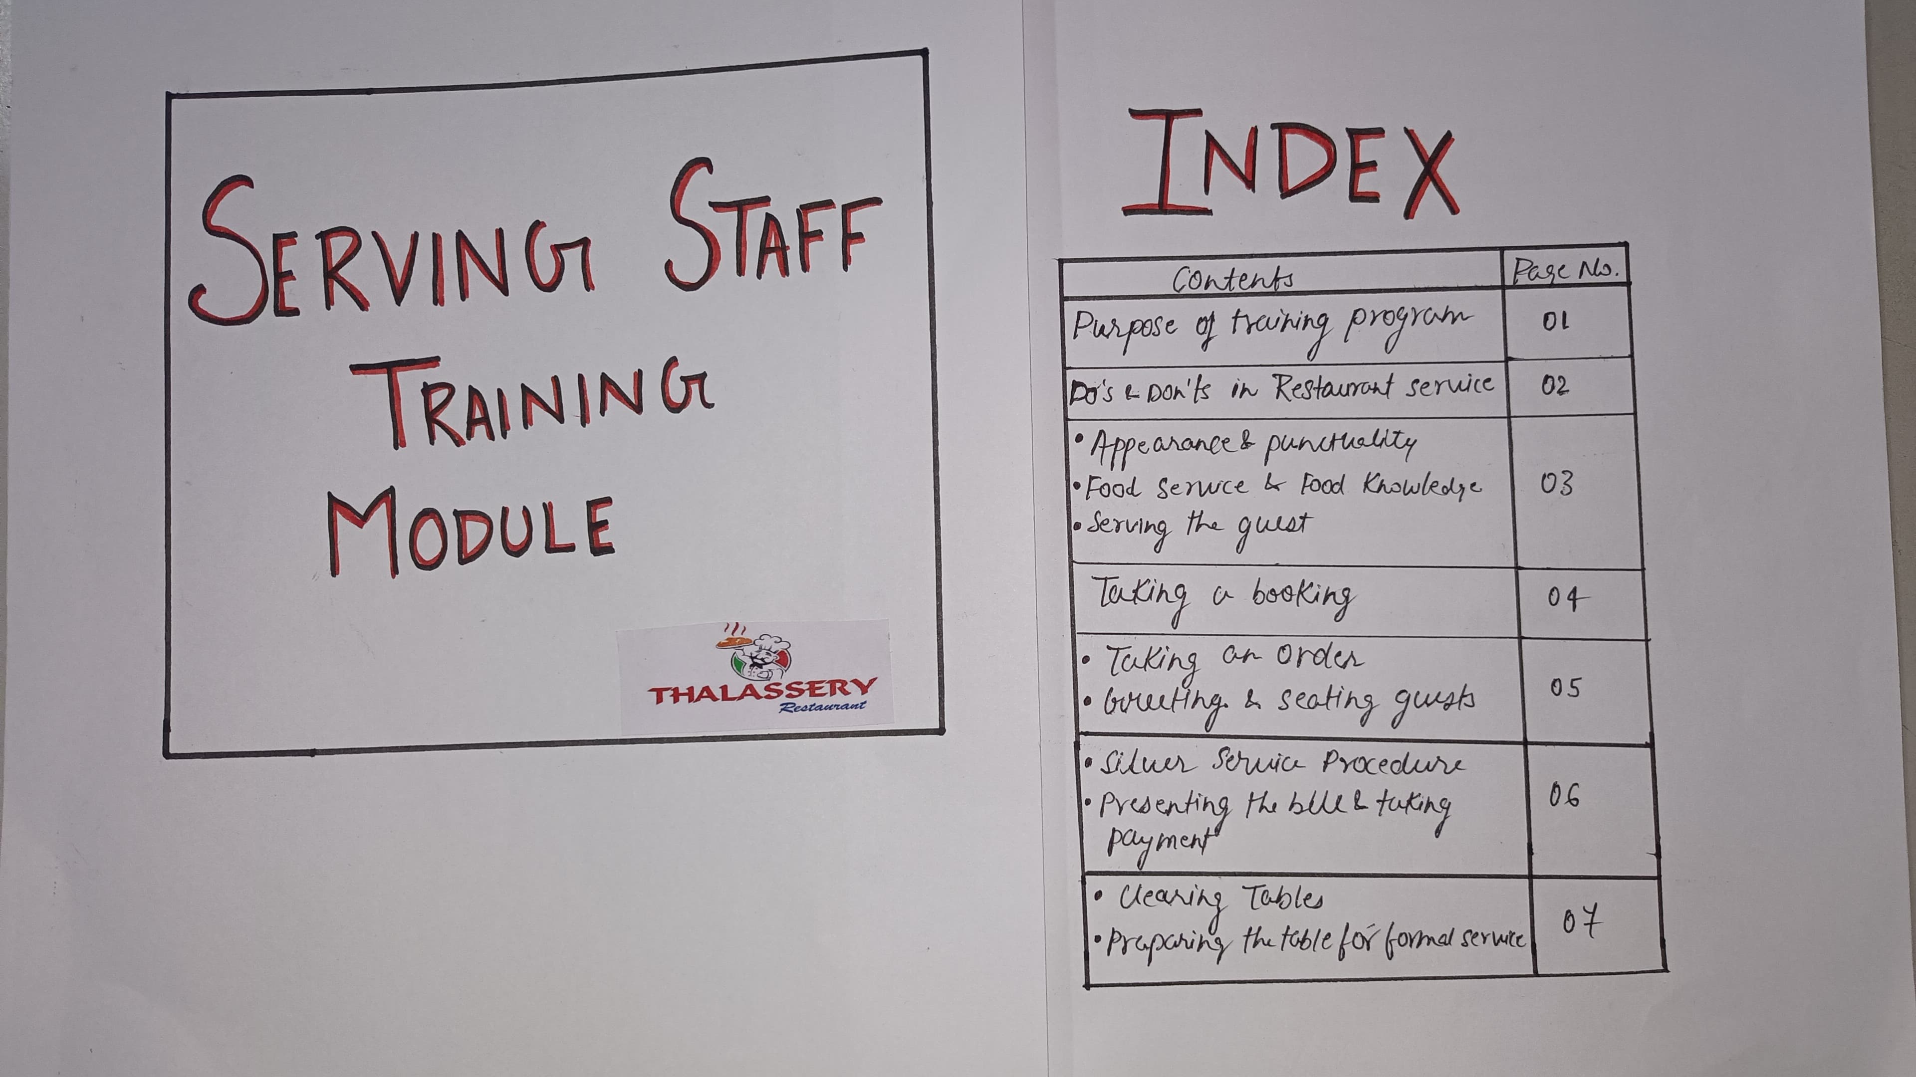

Slide 13
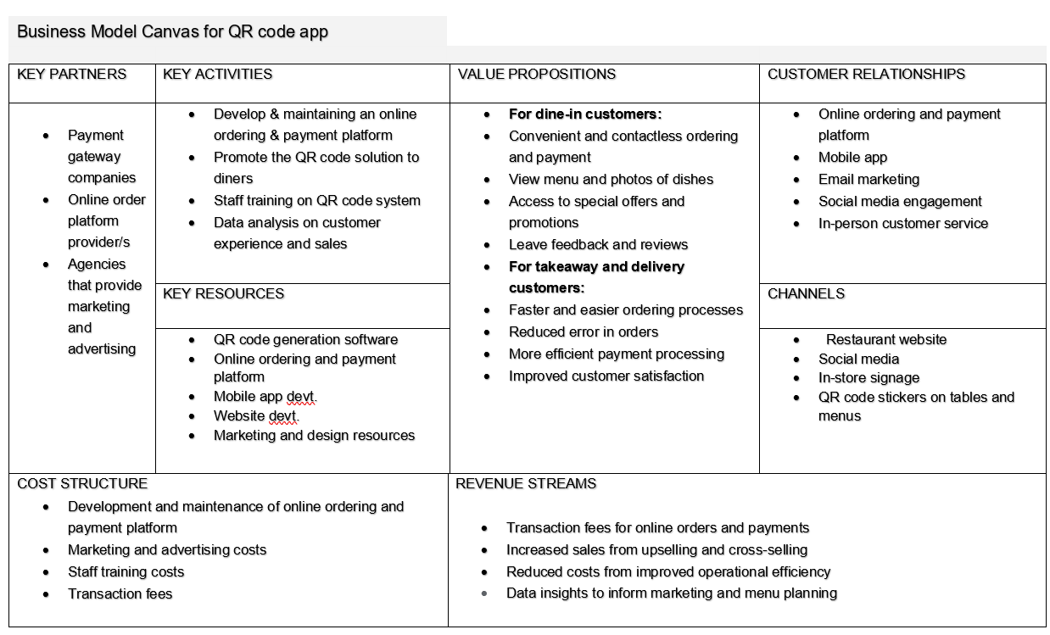
BUSINESS MODEL CANVAS

Slide 14
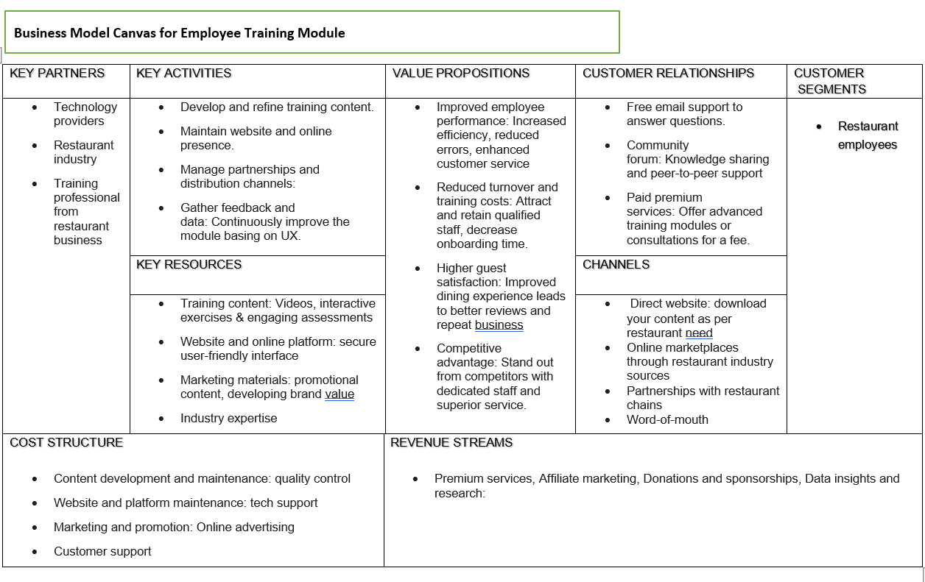

Slide 15
RESOURCES THAT COMPANY WILL HAVE TO DEPLOY TO IMPLEMENT YOUR SOLUTION
QR code creation and food menu retrieval in local language . All this will be on Thalassery restaurant’s management platform.
Mobile friendly menu holding, payment integration and prescriptive analytics.
Tabletop signage.
Hiring a consultant to set up the QR code system and integrate it with your existing.
Restaurant staff training on using QR code system- Training module.
Team building training module, team building games like roleplay, rewards on peer feedback at months end.
High speed Internet Connection (free WIFI)
Robust data security measures to protect customer information Quick Heal data security for 1 year.
For disabled customers, Platform lift.

Slide 16
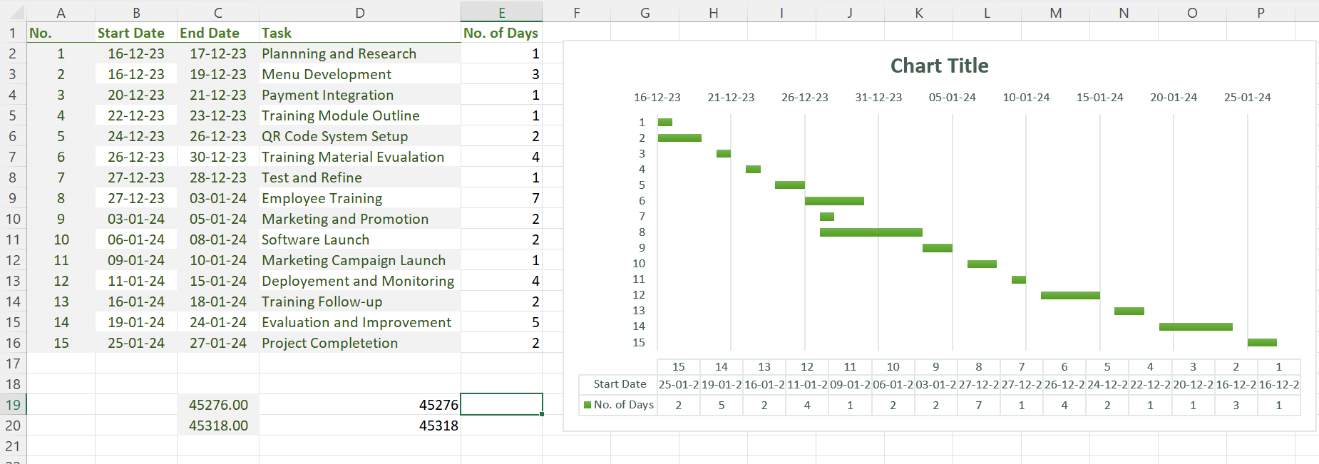
GANTT CHART

Slide 17
Financials
Solution 1 (QR Code and Website Integration): On Hold
Financials: This involves costs for website development, integration with existing systems, maintenance, and marketing to inform customers about this new feature.
Expected cost will be around ₹ 10,000. We are expecting rise in footfall and Profit increase by more than 15%. It was good but owner chose to go with solution 2 first.
Solution 2 (Employee Training Module): Accepted
Financials: The cost would involve creating the training module, which includes content creation, possibly hiring a professional trainer, and maintenance of the online portal. Since it’s cost-effective, it might not require a significant budget.
Zero cost solution, It has increased footfall. Google review rating shot up from 3.5 to 3.7 in 2 months.
Solution 3 (Ramp or Lift): Rejected
Financials: This involves construction costs for building a ramp or installing a lift. It also includes maintenance costs but will enhance customer experience significantly. This will cost nearly ₹35000 – 50000. This seemed not feasible solution , so was discarded by the restaurant manager.

Slide 18
Testing Questionnaire
Solution 1 (QR code payment and menu integration):
For Employees:
How has the QR code system affected your workflow?
Have you encountered any issues while using the new system?
Do you think the new system has improved efficiency?
For Customers:
How was your experience using our digital menu and payment system?
Did you find the QR code system easy to use?
Did the new system improve your overall dining experience?
Solution 2 (Employee Training Module):
For Employees:
Did the training improve your service skills?
Are there specific areas you feel need more focus in the training?
How has the training impacted your interaction with customers?
For Customers:
Have you noticed an improvement in service quality?
Did the staff seem more professional after the training?
Would you recommend our restaurant to others based on the service quality?

Slide 19
Feedback from Organization
Solution 1 (QR Code and Website Integration):
Positive Reaction: The organization was excited about the potential for increased efficiency and customer satisfaction. They appreciated the innovative approach to streamlining the ordering process.
Concerns: There were concerns about the cost of website development and integration with existing systems. Some members were also worried about potential resistance from customers who prefer traditional ordering methods. This concerns led to hold the solution 1 and they preferred to go with zero cost solution that is Solution 2.
Solution 2 (Employee Training Module): ACCEPETED
Positive Reaction: The organization agreed that improving service quality is crucial for customer satisfaction. They liked the idea of a cost-effective online training module.
Solution 3 (Ramp or Lift): was rejected due to cost constraint.
Positive Reaction: The organization recognized the importance of accessibility and was supportive of the idea to improve their facilities.
Concerns: There were concerns about the construction and maintenance costs. Some members also raised questions about the feasibility of the construction work, given the space constraints of the restaurant.

Slide 20
Final Outcome
Employee Training module is accepted by them due to low cost and feasibility to make changes but module has to be made into local language and needs to be integrated with video module for demonstration. In that case , both written and video module has to be uploaded in LMS of Thalassery restaurant.
Time to train employees is not available.
QR code with website and payment integration is under testing stage.
They were assertive to deploy QR code with menu integration.

